Slide 1
Deep Q-Learning Aided Networking, Caching, and Computing Resources Allocation in Software-Deﬁned
Satellite-Terrestrial Networks
IEEE TRANSACTIONS ON VEHICULAR TECHNOLOGY, VOL. 68, NO. 6, JUNE 2019
Notes:
這篇作者將DQN運用在SDN的衛星地面網路上，那主要是使用DQN進行資源分配

Slide 2
INTRODUCTION
Software-deﬁned satellite-terrestrial network framework
A single physical satellite network enables to be virtualized into several virtual satellite networks to share networking resources.
Notes:
傳統的TCP/IP mobility低，heavy overheads、high complexity，作者不想再衛星地面網路使用TCP/IP
於是他把SDN運用在衛星地面網路上，將control plane從data plane中分離，control plane的部分改以軟體實做，SDN架構可在不更動硬體裝置的前提下規劃網路並且控制流量。SDN其中一個特點就是虛擬化，一個實體的satellite network 可以被切成好幾個虛擬的satellite network ，根據其他論問的研究指出capital expenses(成本支出) & operation expenses(運營費用)會大幅降低

Slide 3
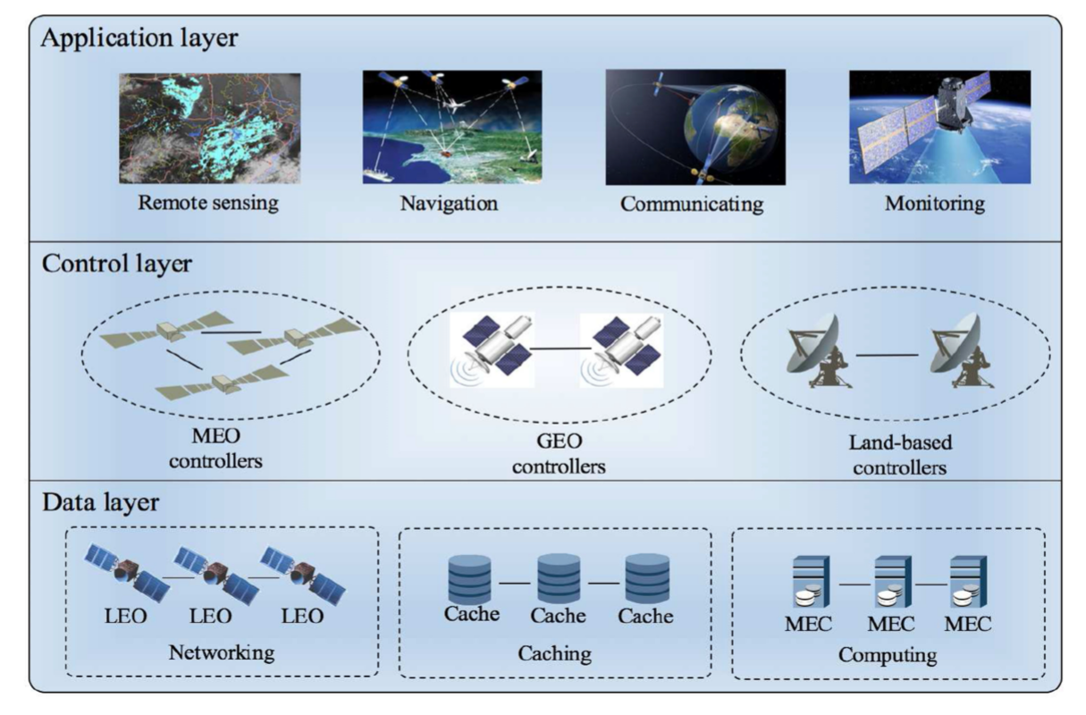
Framework of Software-Deﬁned Satellite-Terrestrial Networks
Notes:
此架構包含data layer, control layer, and application layer, 在data layer 有LEO作為network infrastructures，caching，edge computing(衛星的計算能力有限，並且若採用雲計算，考量到長距離以及大量資料，雲計算不算是好方法，這邊要採取的是edge computing)
在control layer中，我們的control intelligence可能是MEO、GEO或land-based controllers。控制層是此框架的核心，它負責控制和管理data layer中的多個資源，控制層可將networking，caching和computing資源根據用戶需求進行動態分配，
在應用程序層中提供了許多應用程序，包括遙感，導航，通信和監視。

Slide 4
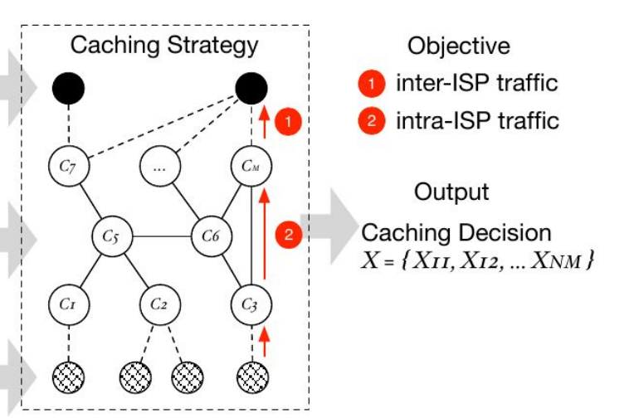
Satellite-Terrestrial Networks With Caching
Host-centric v.s. Information-centric networking
in-network caching
Notes:
Host-centric : 假設我要傳送一個封包給一指定的address, 傳送的方式是host to another host,是host 之間的溝通。 而information-centric 是今天我想要一個某資料我就直接在網路上拿取這筆資料，我不用知道這筆資料的來源是誰，我只要知道這筆資料的identifier 我就有機會可以找到這筆資料) 在衛星網路中很難用傳統host-centric approaches的方式傳遞，因為propagation delay很長，high data error，intermittent connection(斷斷續續的連接)以及high mobility，為了解決此問題 要採用的方法是information-centric的in-network caching ，那Cache就是把常常用到或可能用到的資料先暫存起來，那需要用到的時候就可以比較快使用 In-network caching是代表不只有單個cache 而是有好幾個cache組成。

Slide 5
Example about the workﬂow of this framework
Company LOGO
A user issues a content request to a LEO that covers this user
Check whether this content is cached in its associated cache
If no, do sensing and retrieve the result
Notes:
1.User發出request(例如想要一段監控的影像)給在他範圍內的LEO
2.LEO會先去確認此內容是否已在associated cache, 若有，則檢查版本是否一樣，若一樣則回傳對應content。若版本不同則建置一task給MEC，MEC則執行完將結果回傳user。若不在associated cache裡則檢查所有的content cache，若有就執行剛剛的步驟，若還是沒有就會去使用衛星感測想要的資料再回傳。

Slide 6
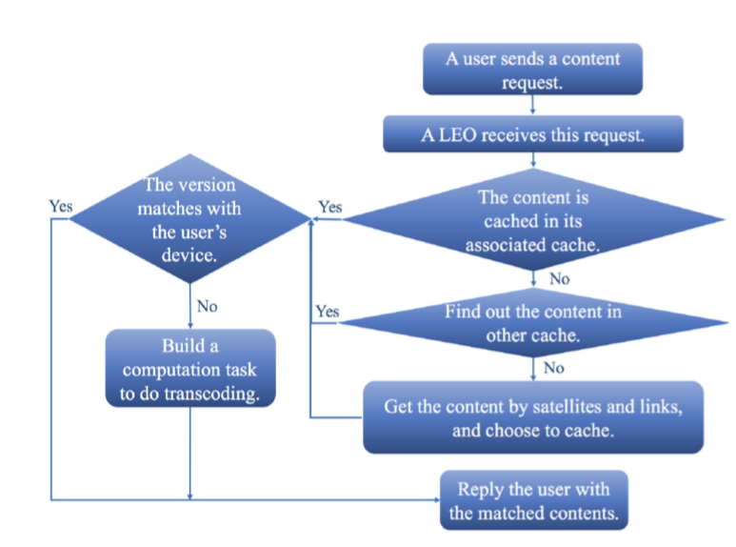
An example about the workﬂow of this framework
Company LOGO
Notes:
1.User發出request(例如想要一段監控的影像)給在他範圍內的LEO
2.LEO會先去確認此內容是否已在associated cache, 若有，則檢查版本是否一樣，若一樣則回傳對應content。若版本不同則建置一task給MEC，MEC則執行完將結果回傳user。若不在associated cache裡則檢查所有的content cache，若有就執行剛剛的步驟，若還是沒有就會去使用衛星感測想要的資料再回傳。

Slide 7
Deep Q-learning
From this example, we can see that networking, caching, and computing are all enabling resources for users’ requirements.
Learning agent : Orchestrator
Notes:
根據剛剛的例子我們可以看到user的需求可能有networking, caching, computing ，但若要將這些考慮進去將會非常困難，於是作者希望透過DQN來達到目標。

Slide 8
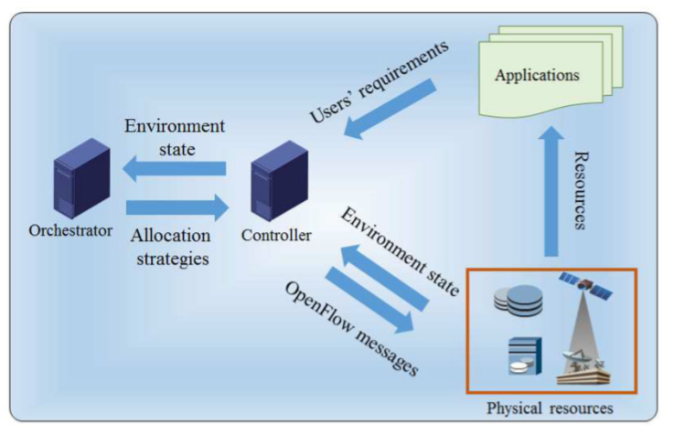
Data ﬂows among the proposed framework
The resources allocation strategies are made by orchestrators.
Notes:
這張圖是這個架構的data flow是意圖
controller 接收 users’ requirements 並分配資源(networking resources ， caching resources ，computing resources ) 以配合user’ requirements
那資源分配的strategies是orchestrator制定的，但orchestrator如何制定呢? 只需要從controller 那邊獲得training data即可進行訓練。

Slide 9
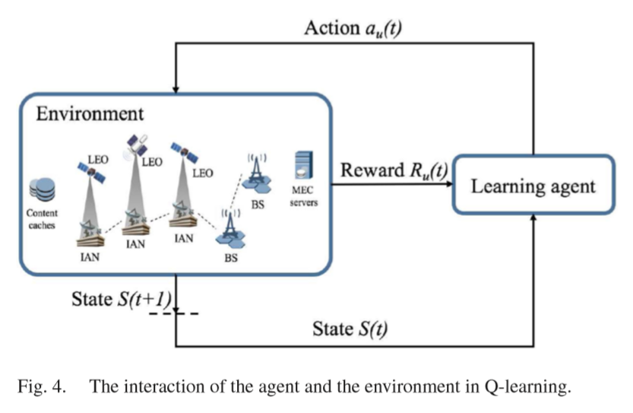
The interaction of the agent and the environment in Q-learning
Notes:
簡單來說我們要訓練一個agent可以去適應我的environment，
agent會將我的environment的每個時間點的觀察集合 做為一個state ，從state跟reward來去選最好的action，也就是policy
再environment會接收agent執行的action 並吐出reward跟observation給agent

Slide 10



Y’ x Y’ angle atate transition probability matrix $K_{u}^{l}$(t) between user u and LEO l is denoted as
Notes:
User u 與LEO l 的最大角度(因為有Light of sight的限制,
State Xs ->Bs的機率為KXsBs(t)

Slide 11
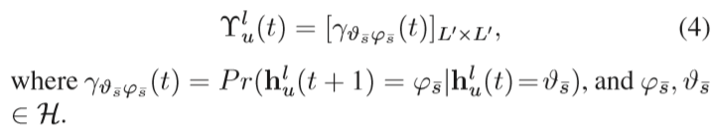
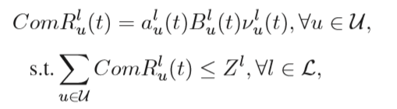

Communication Model
The received SNR of user u from LEO l is modeled as a random variable $h_{u}^{l}$.
Notes:
這邊也跟剛剛一樣，但這邊是根據頻道中的SNR來做切割， $h_{u}^{l} 就是$ user u 收到LEO u 的 SNR 所建置的一個隨機變數

Slide 12

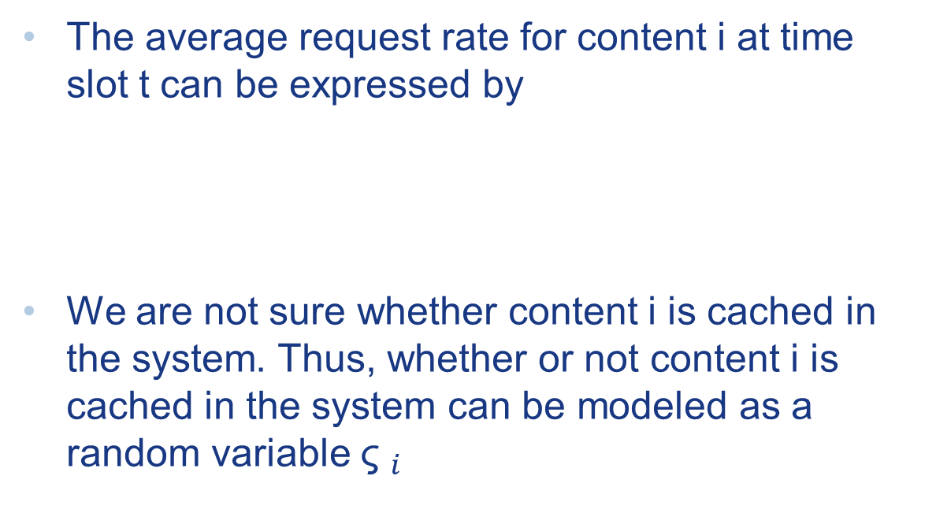
Caching Model
The average request rate for content i at time slot t can be expressed by
We are not sure whether content i is cached in the system. Thus, whether or not content i is cached in the system can be modeled as a random variable ${\text{ς} }_{i}$

Slide 13
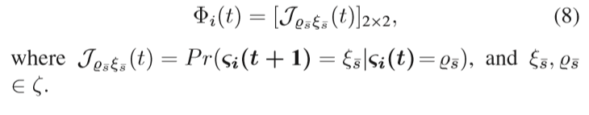
There are two states: if content i is not cached, state 0; if content i is cached, state 1.

Slide 14
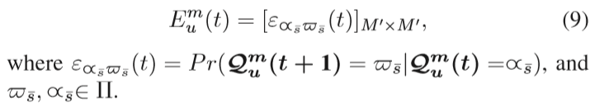

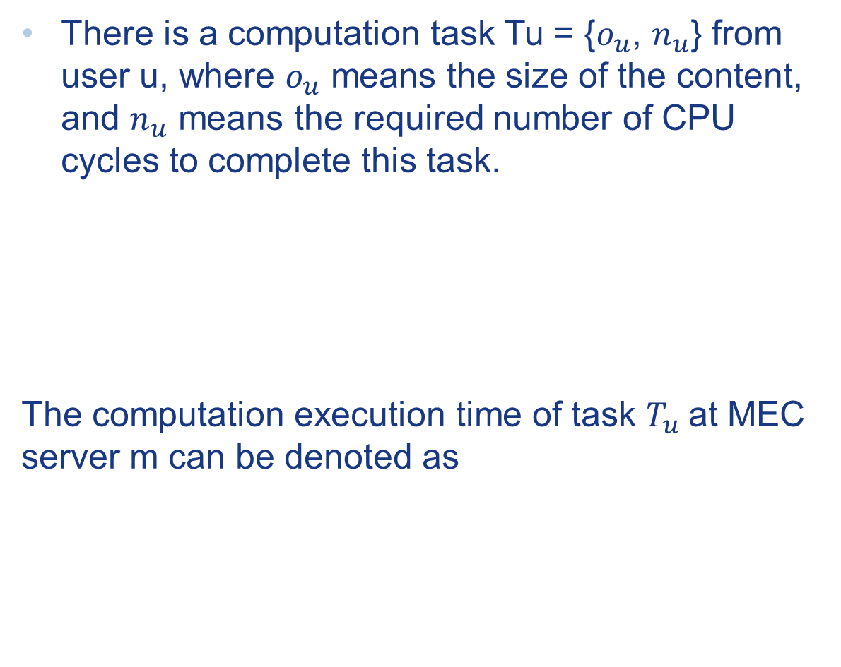
Computing Model
There is a computation task Tu = {$o_{u}$, $n_{u}$} from user u, where $o_{u}$ means the size of the content, and $n_{u}$ means the required number of CPU cycles to complete this task.
The computation execution time of task $T_{u}$at MEC server m can be denoted as
Notes:
$o_{u}$代表content大小$,n_{u}$代表要幾個cycles ，這邊也是跟剛剛一樣 做一個機率矩陣 去存他的 $Q_{u}^{m}($computation capability)

Slide 15
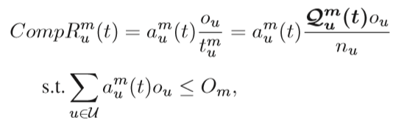
So the computation rate is:

Slide 16
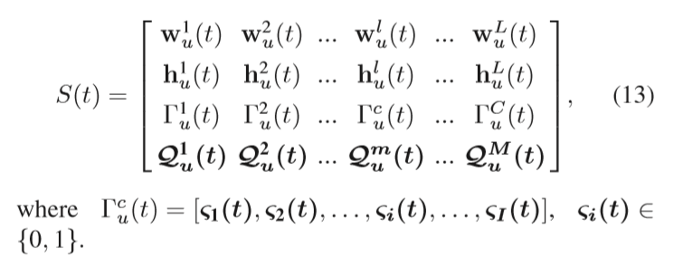
State Space
The state space consists angle state, networking state, caching state, and computing state.

Slide 17
Action Space
Which LEO is assigned to user u
Whether or not the content requested by user u should be cached
Which MEC server should execute the computation task from user u
Notes:
在該系統中，代理需要確定將哪個LEO分配給用戶u，是否應緩存用戶u請求的內容，以及哪個MEC服務器應執行用戶u的計算任務

Slide 18



action space
action space $a_{u}$(t) at time instant t is represented as:

Slide 19

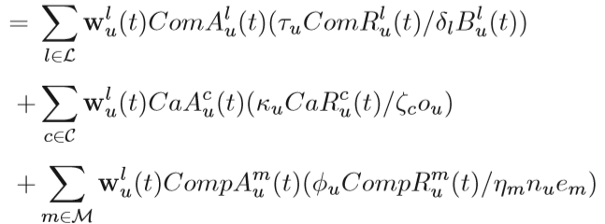
Reward Function

Slide 20
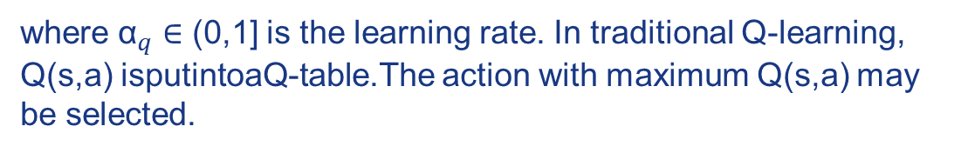
Q function
where ${\text{α}}_{q}$ ∈ (0,1] is the learning rate. In traditional Q-learning, Q(s,a) isputintoaQ-table.The action with maximum Q(s,a) may be selected.

Slide 21
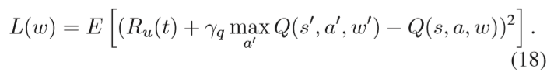
Deep Q-Learning
In each learning iteration, deep networks are trained to minimize loss function.

